Slide 1
Big Mountain Resort Pricing Strategy
Created for
Jimmy Blackburn and Alesha Eisen

Slide 2
Problem Identification
What is the most cost efficient ticket price Big Mountain Resort can charge its expected customers, in relation its current price and market evaluation?
Considerations
Upcoming season (2023-24)
350,000 skiers
Incurred cost of added chair lift ($1.54m)

Slide 3
Recommendation:
Increases to Runs, Vertical Drop, Total Chairs, Snow Making Acres
Ticket Price Increase of $9.90 (currently $81.00 for average adult weekend day pass) resulting in
$17.3m of Revenue*
Expenditures:
1 additional ski run, 150 feet increased vertical drop, 1 additional chair lift, 2 acres of snow making capability
*Assumption: Visitor buys 5 tickets

Slide 4
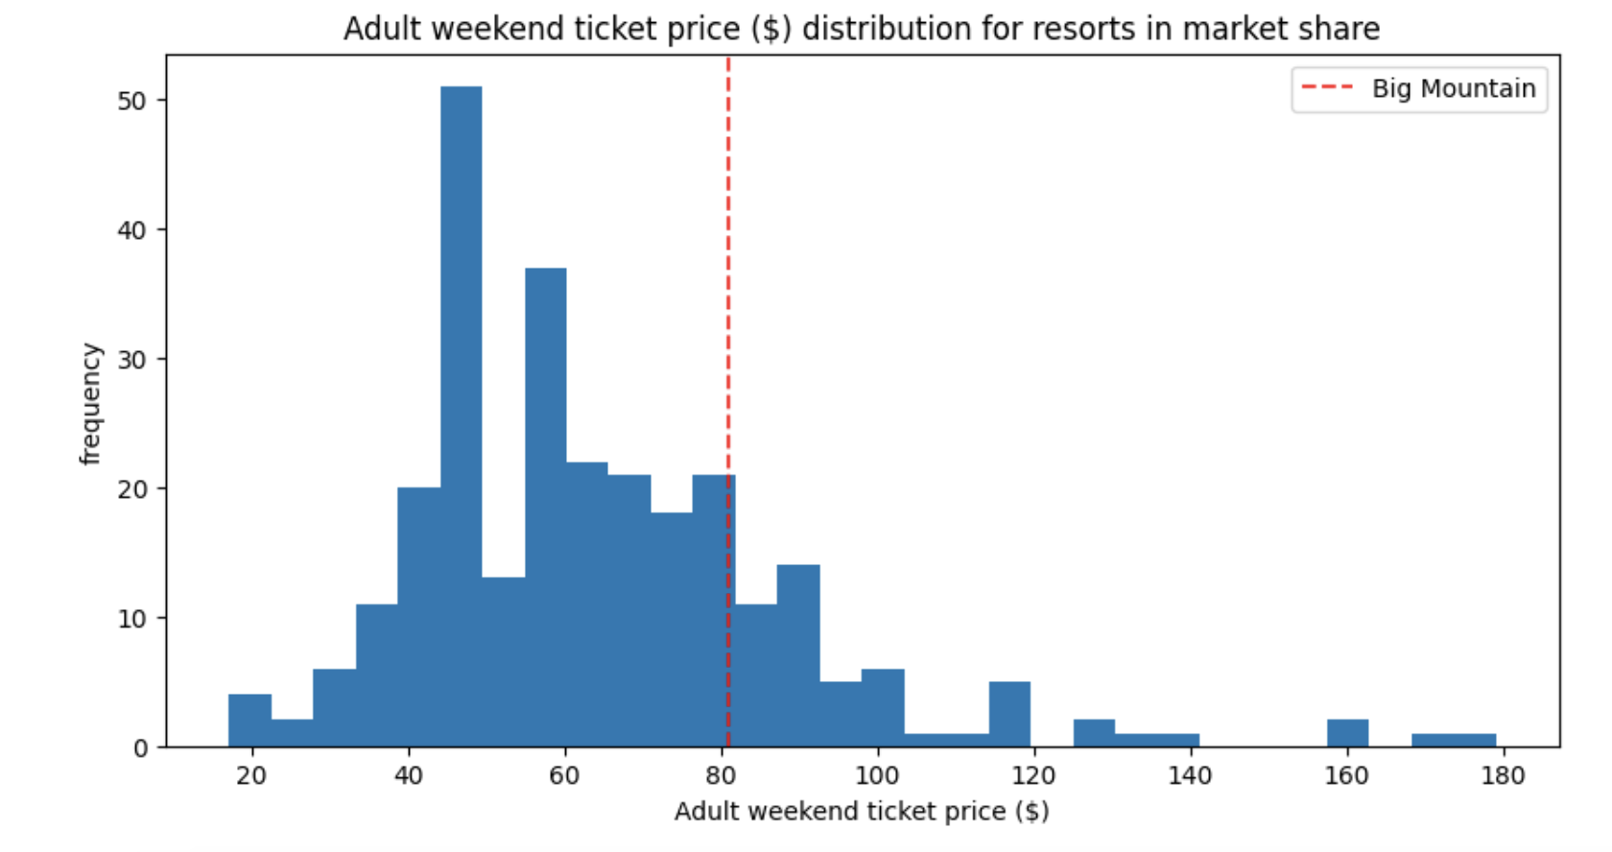
Results: BMR vs Competition
Price Point
Big Mountain Resort is just beyond the mid to higher range in average ticket price
The majority of US resorts have their ticket price below $81 for the average weekend

Slide 5
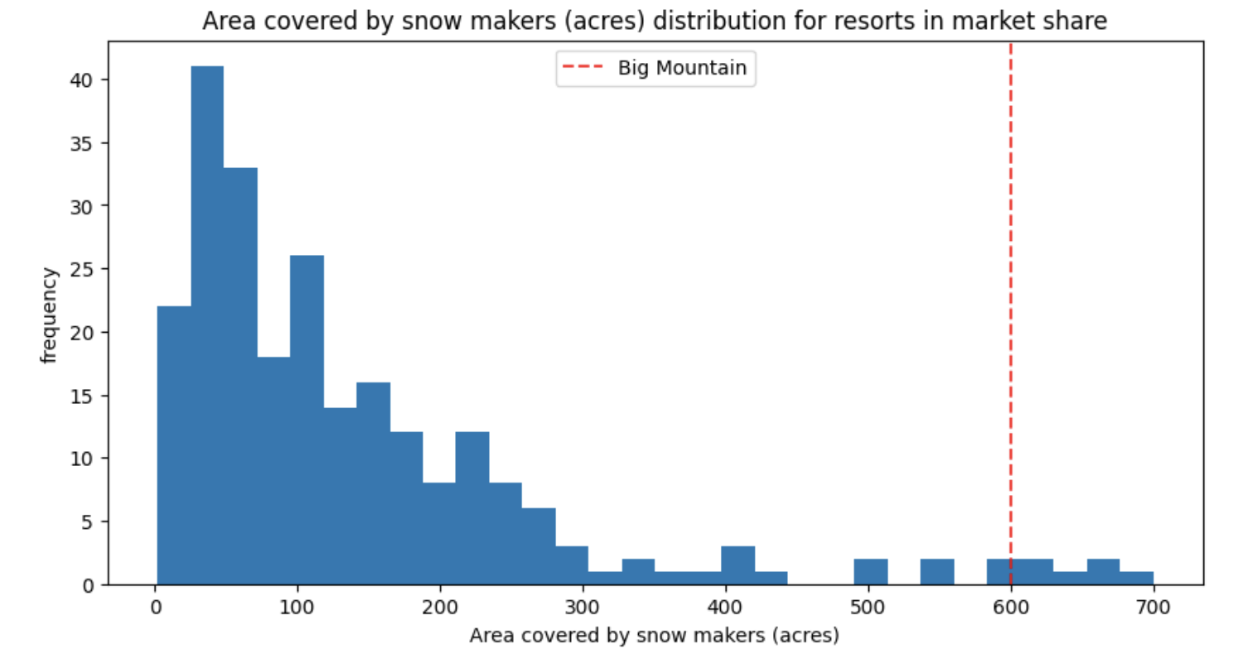
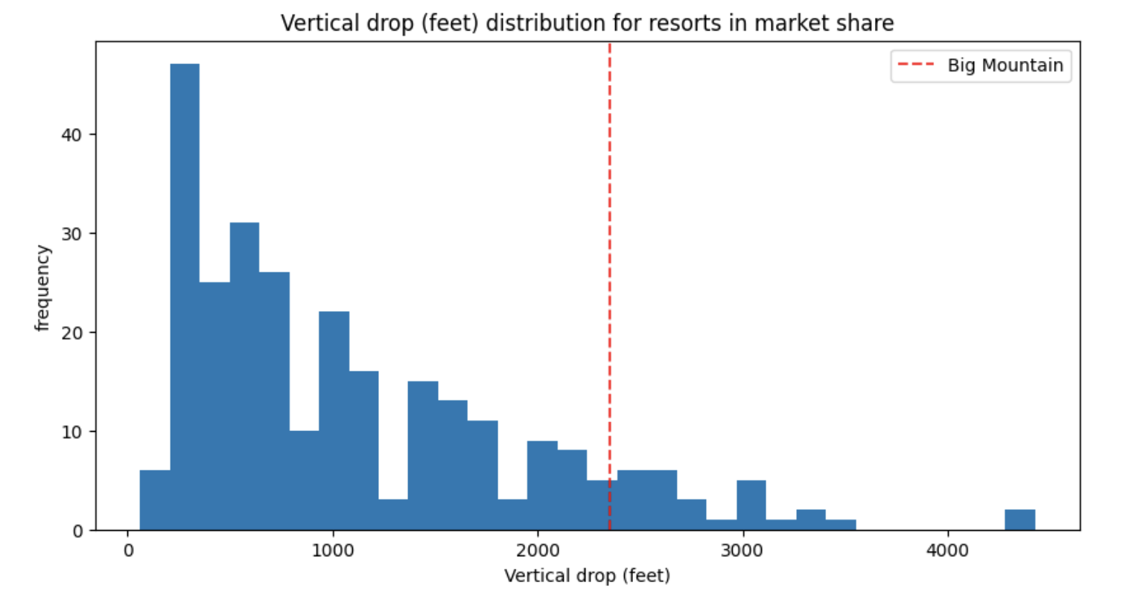
Results: BMR vs Competition
Strengths
BMR’s features are rank highly against its competition, which poses a reevaluation in BMR ticket price
Snow making acres
Vertical drop
Runs

Slide 6
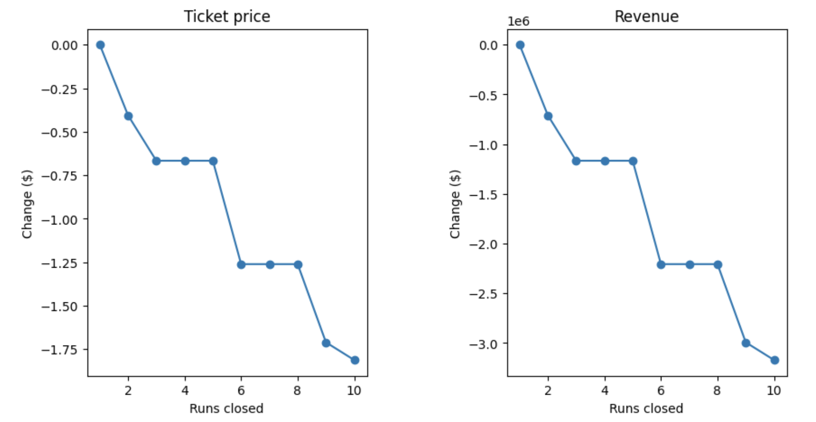
Scenario: BMR Cuts Runs
Predicting Cost Cutting Measures
BMR could reduce the number of ski runs it services
Reducing runs has a direct correlation to ticket price
Price is commensurate with revenue
Opted against this scenario

Slide 7
Plan of Action: BMR Invests
Instead, BMR will improve on its features to justify the price point increase, in an effort for long term growth
At face value, profit stands to be around $15m when factoring chair lift cost
Next steps: Calculate additional cost of other feature enhancements

